Slide 1

Join the Live Net Zero 2025 Classroom Challenge
Your class can complete up to 10 of the following Challenges and be eligible to win cash prizes by entering on or before 15 November 2025!
Register and get the instructions at www.LiveNetZero.org
English & French slides.

Slide 2
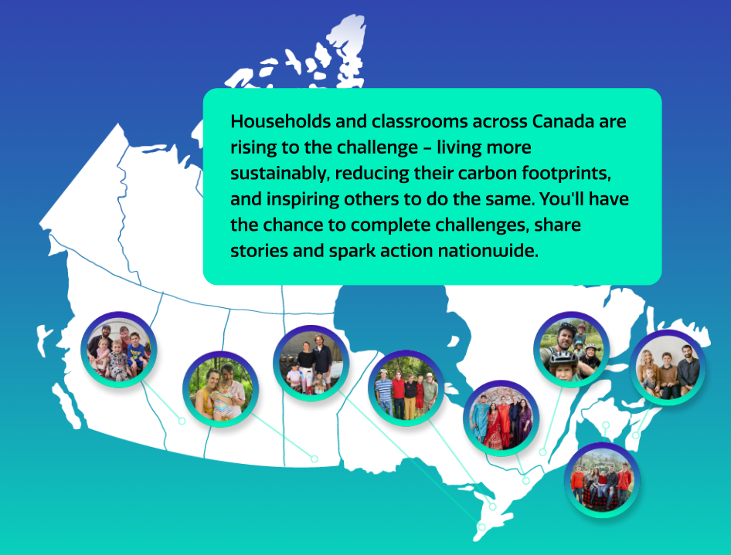


Slide 3
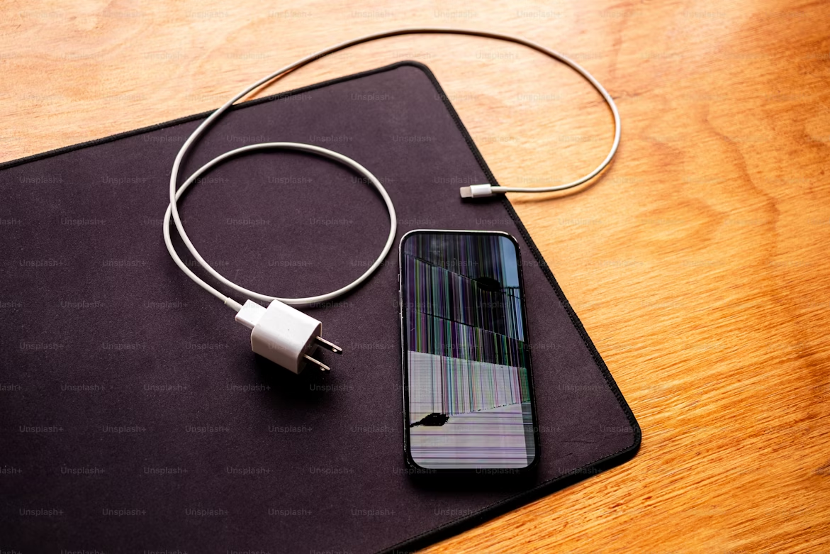

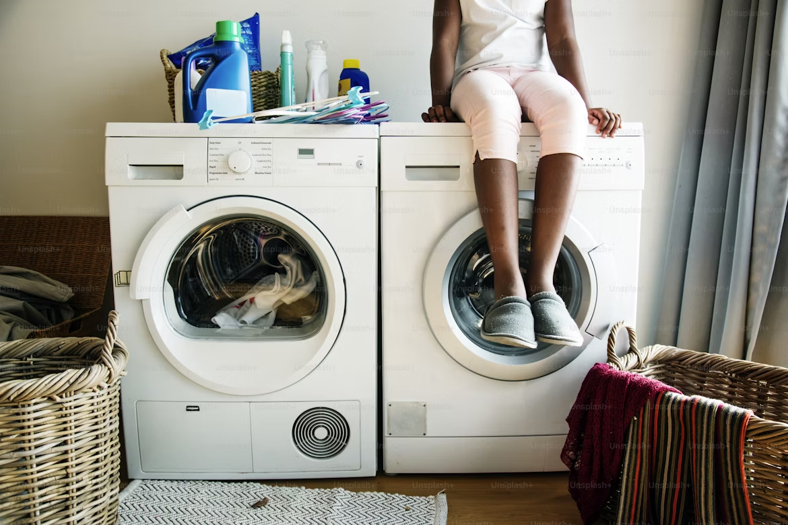
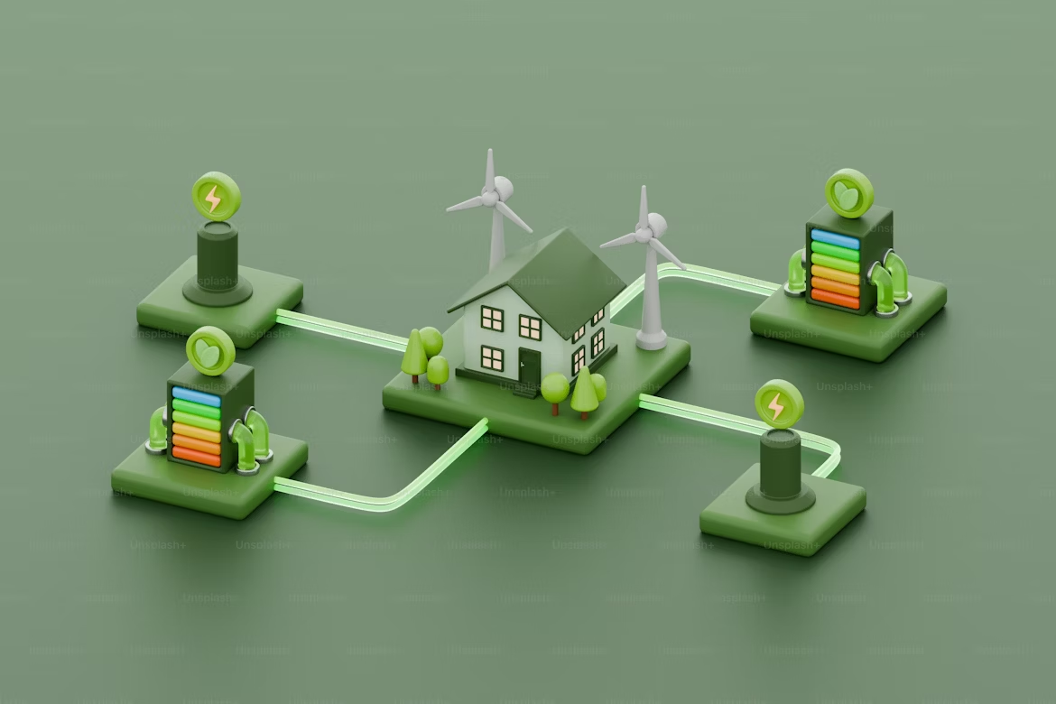
Our Homes & Energy
Power Down Challenge
Track your device use and try cutting back for a day. Reflect on how it affects your habits, energy use and mood.
Water-Wise Challenge
Track your water use and explore traditional or cultural connections to water. Create a personal pledge to reduce waste or honour water in your daily life.
Cold-Wash Challenge (Take-Home)
Encourage your household to switch from hot to cold water laundry for a week to save energy. Track results and share how it went.
Green Building Challenge
Design a low-impact home, classroom or building using sustainable features. Learn where homes waste energy and how we can do better.

Slide 4
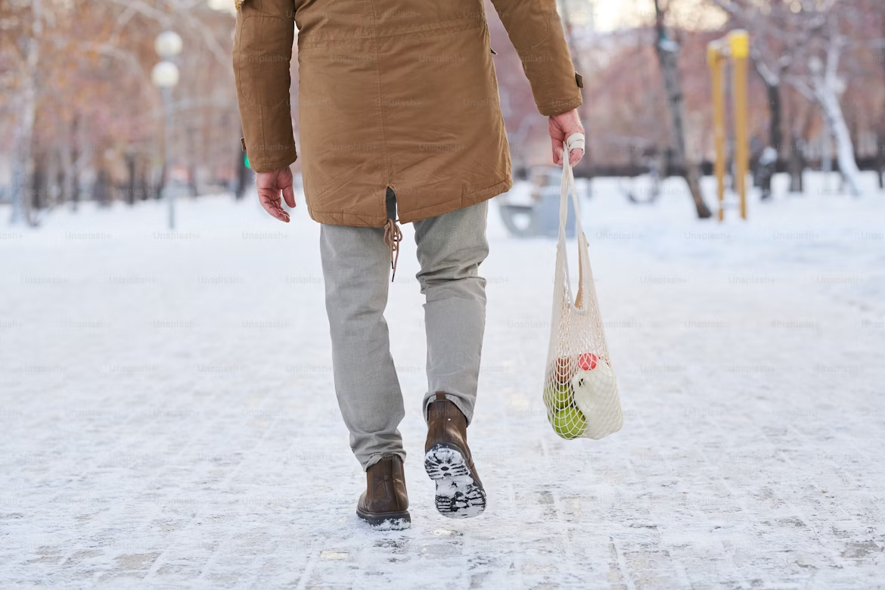
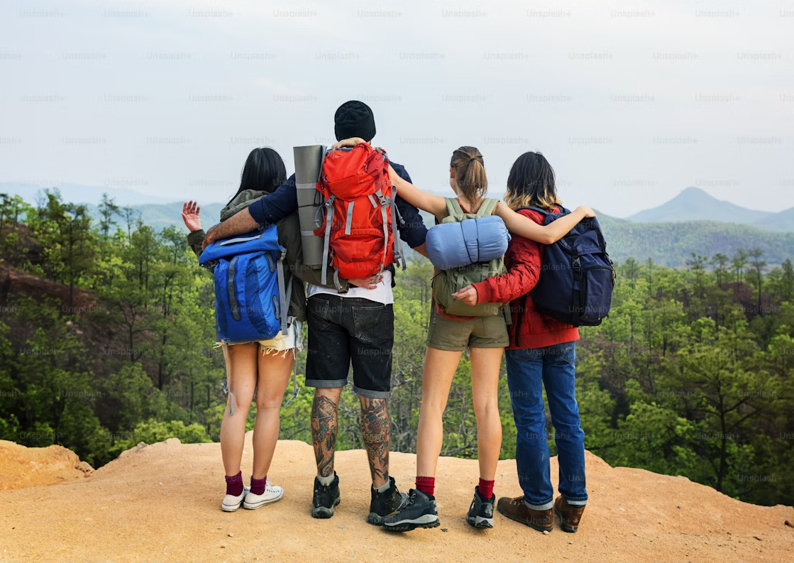
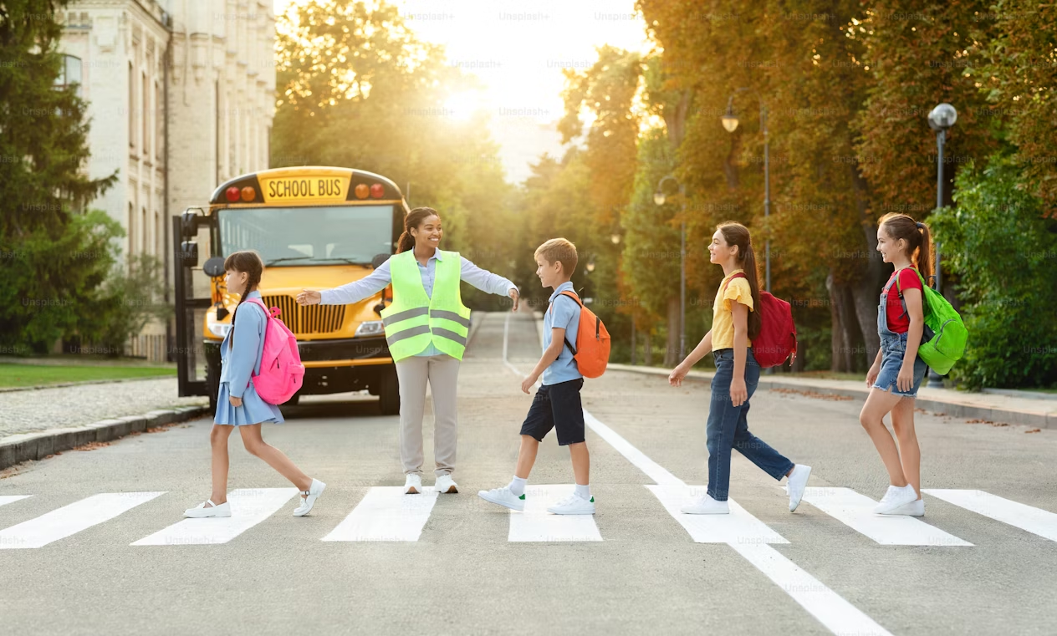
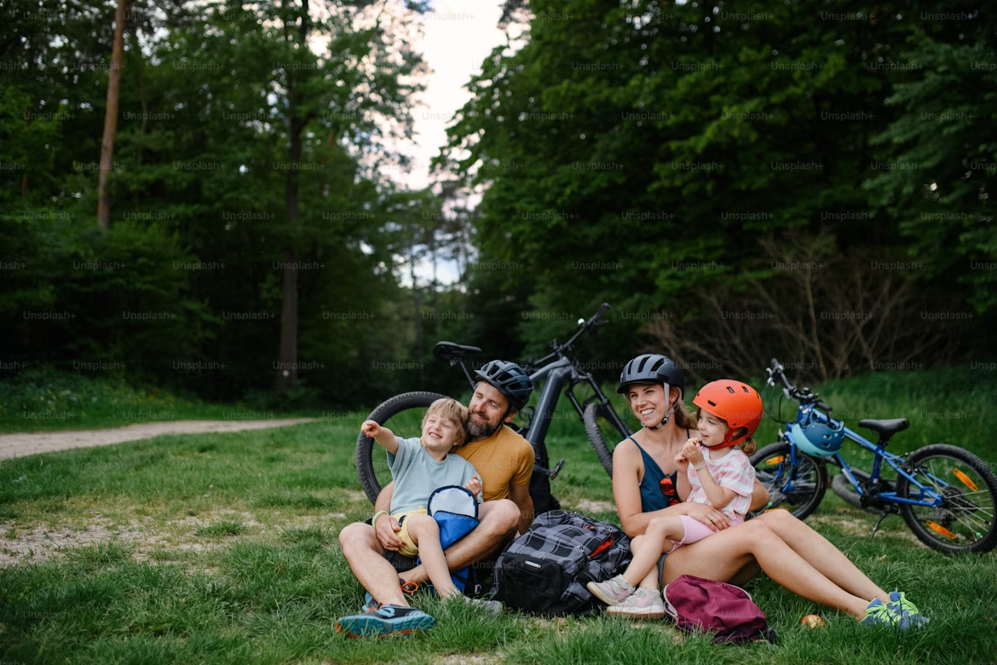
Transportation Equity
Explore different ways to reach key places in your community, like school, the library, or a grocery store, by walking, biking, public transit or car. Reflect on the potential benefits and challenges of each approach, and where the gaps are in making such trips accessible and sustainable for everyone.
Around the World Challenge
Plan a low-emission race between global cities (e.g., Toronto to Tokyo). Consider different routes and travel options to reach your destination with lower emissions.
My Dream Route Map
Design a safer, greener way to move through the community. Map a dream route to school or another key destination, and propose changes — like bike lanes, shaded sidewalks or transit stops — that make streets more accessible and environmentally-friendly.
Getting Around Challenge (Take-Home)
Work with your family to plan an eco-friendly trip – to school, the store or a local spot. Will you walk? Go by bus or bike? Reflect on what made it easy or hard.
How We Get Around

Slide 5
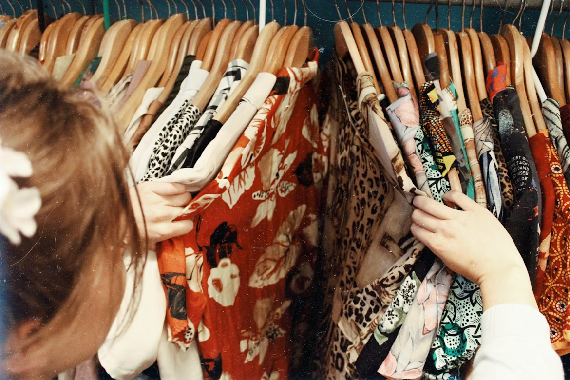
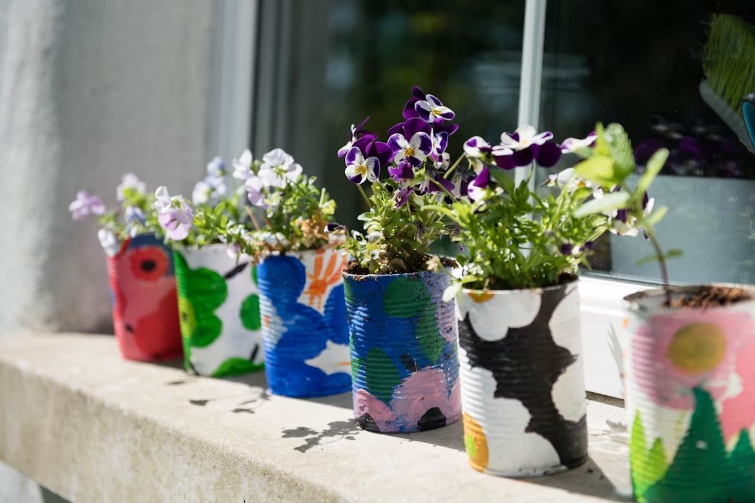

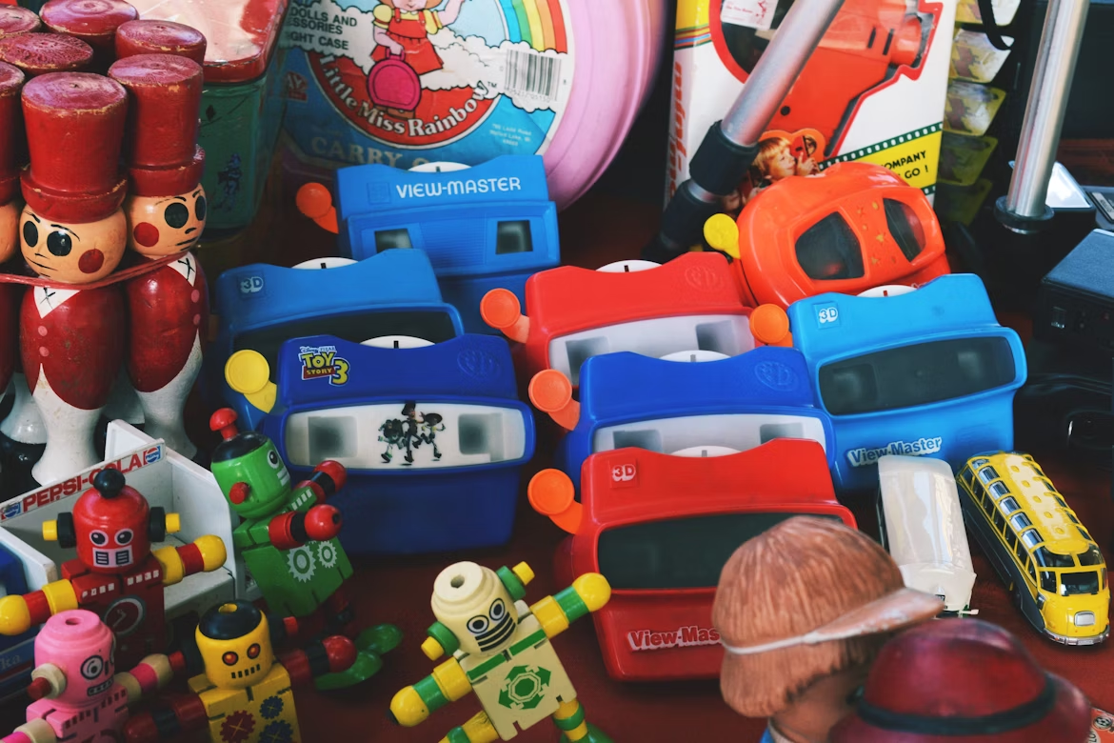
Clothing Rewear & Repair Challenge
Explore how your clothing choices impact the planet. Choose one item to repair, thrift, swap or restyle — then share its story and why wearing what you already own matters.
Upcycle your Stuff Challenge
Repurpose an old or broken item and tell the story of its new life. Explore how creative reuse reduces waste and sparks innovation.
True Cost Challenge
Research how a product is made and its environmental impact over its full life span, and explore alternatives.
Stuff Swap Challenge (Take-Home)
Organize or participate in a swap event for toys, clothes, books or tools. Reflect on how sharing builds community and reduces waste.
Our Stuff

Slide 6
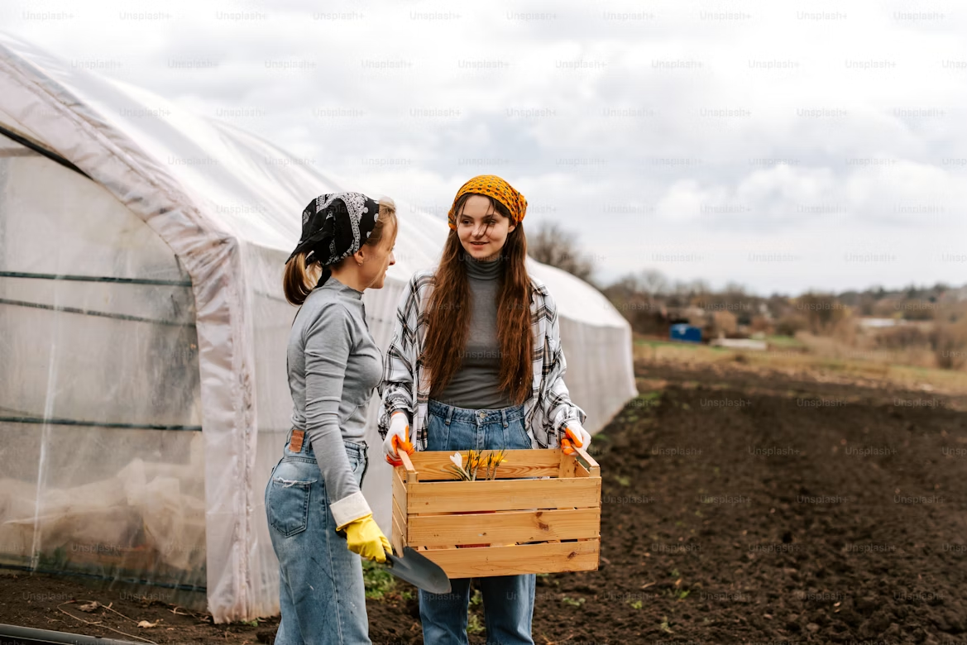
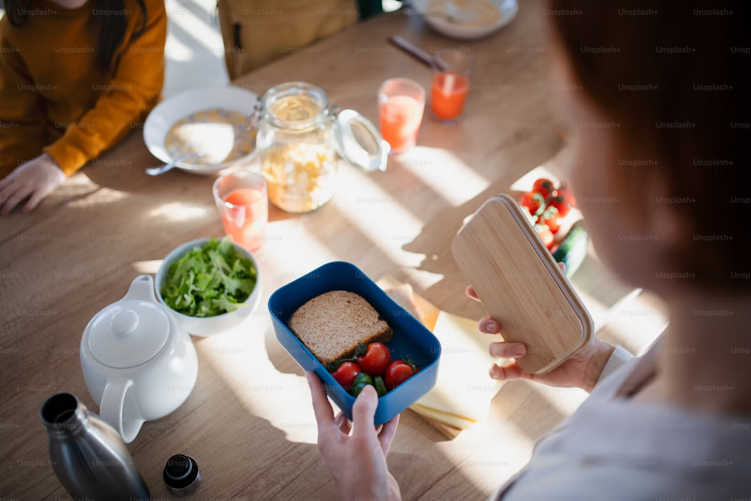
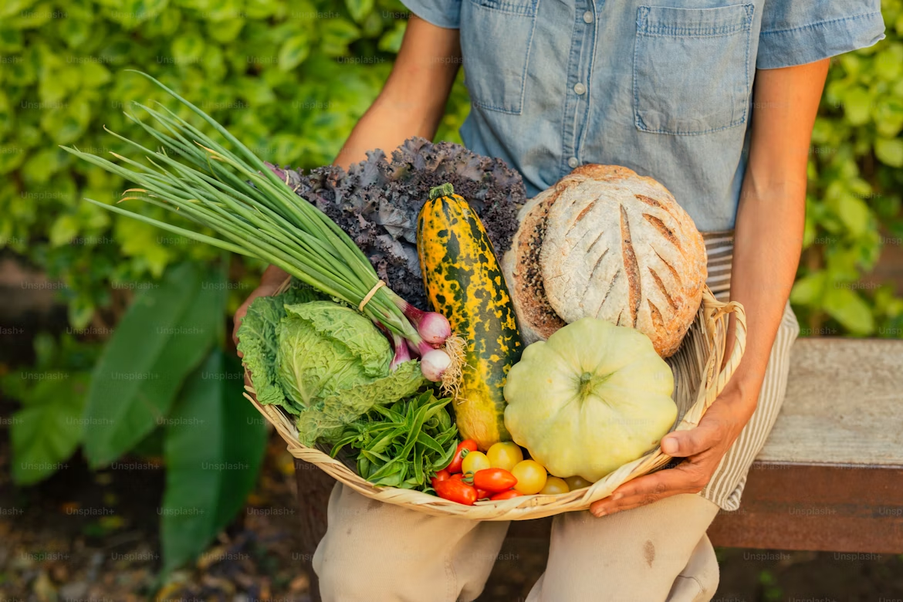
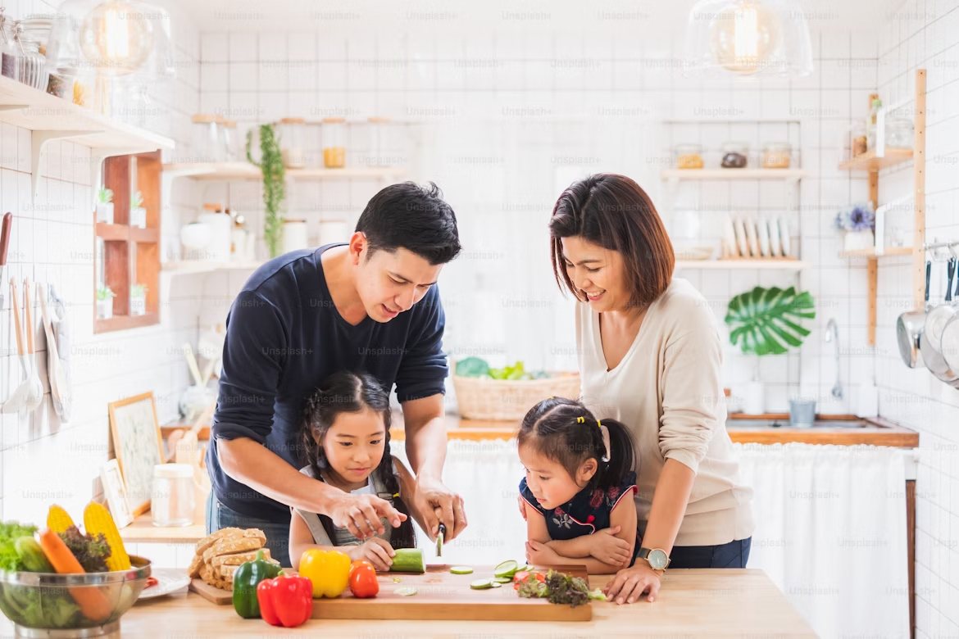
Our Food
Community Connections Challenge
Discover and reflect on local food businesses and other community players and their role in sustainability.
Rescue My Lunch Challenge
Track and reduce your lunch waste at home or school. Plan ways to use leftovers and share rescued recipes or ideas.
Protein Swap Challenge (Take-Home)
Try a plant-rich meal with your family. Explore new recipes and reflect on the experience, including taste, ease and what you enjoyed most.
Local Food Challenge
Research where your food comes from and plan a meal using local or seasonal ingredients. Reflect on how the production, processing and transport of food affect its environmental impact, and how local production can support community resilience.

Slide 7

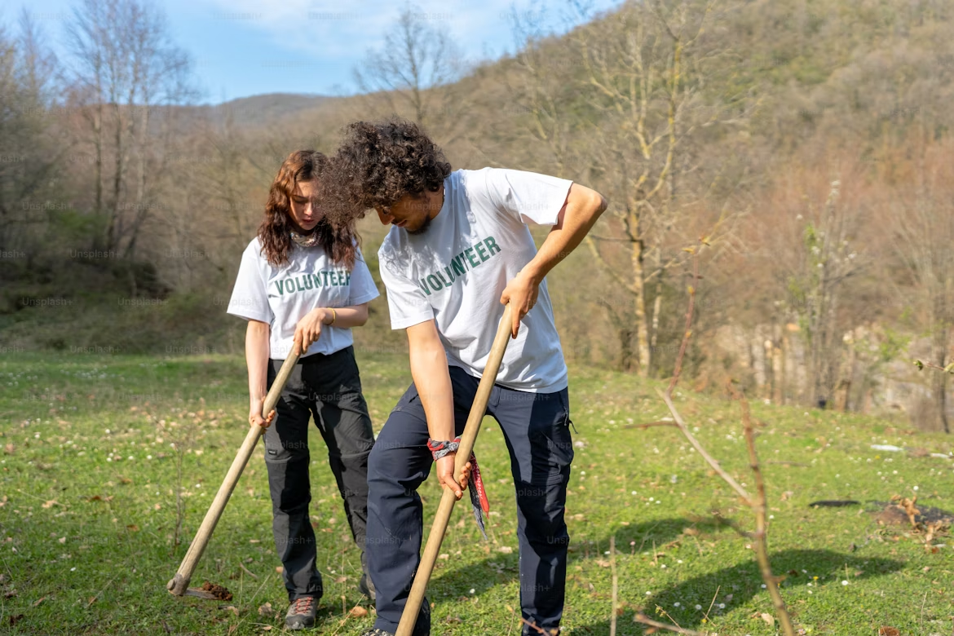
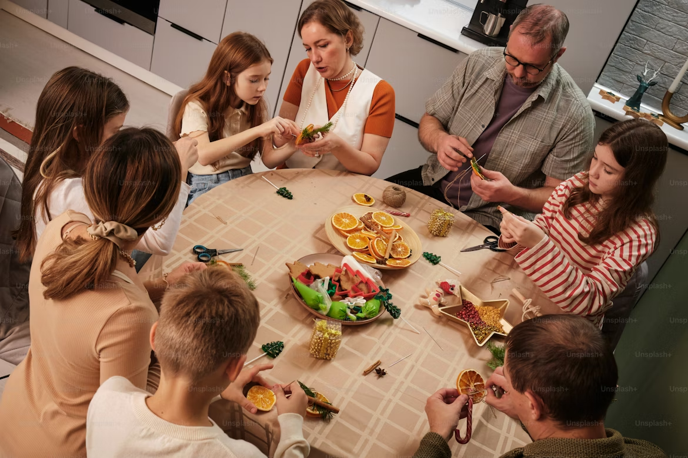
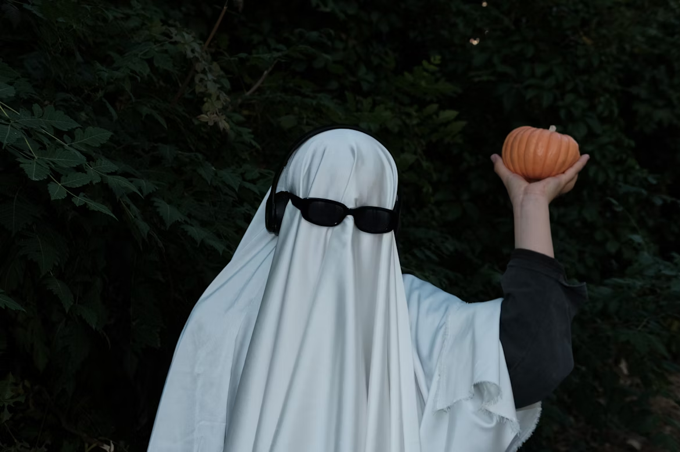
Our Traditions Challenge
Reflect on a personal or cultural tradition (such as a birthday, holiday or community event) and find ways to make it more sustainable without losing what makes it meaningful.
Nature Restoration Challenge
Take action to restore a local green space. Plant native species, clean up an area or join a citizen science project.
Sustainable Celebrations Challenge
Explore how to celebrate meaningfully with a lower footprint. Design decorations, cards, or gifts using reused or recycled materials, and reflect on what truly makes holidays special.
Costume & Decor Challenge (Take-Home)
Create a costume or celebration decor from reused or recycled materials (e.g., for Halloween, a birthday or a school event). Share your design and how you brought it to life.
How We Celebrate and Play

Slide 8
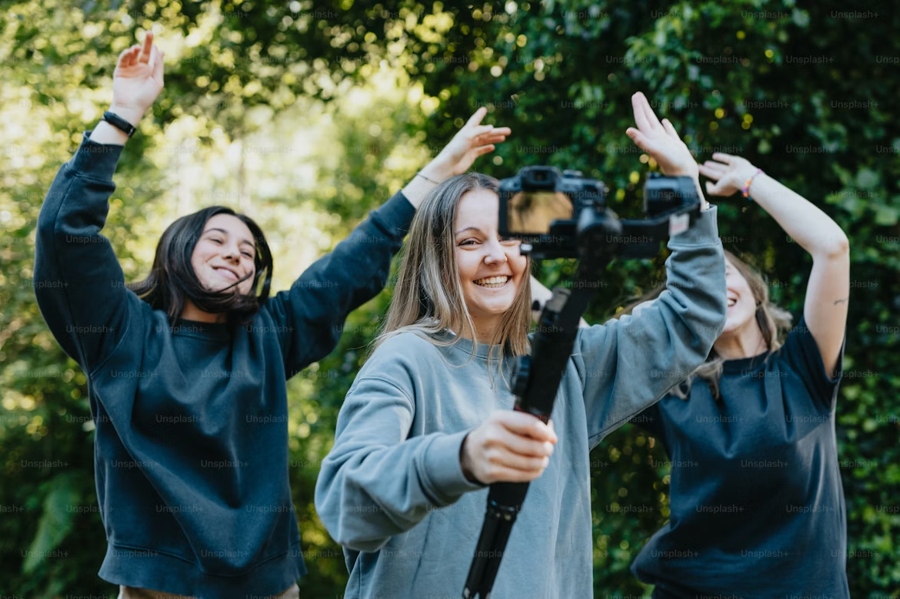

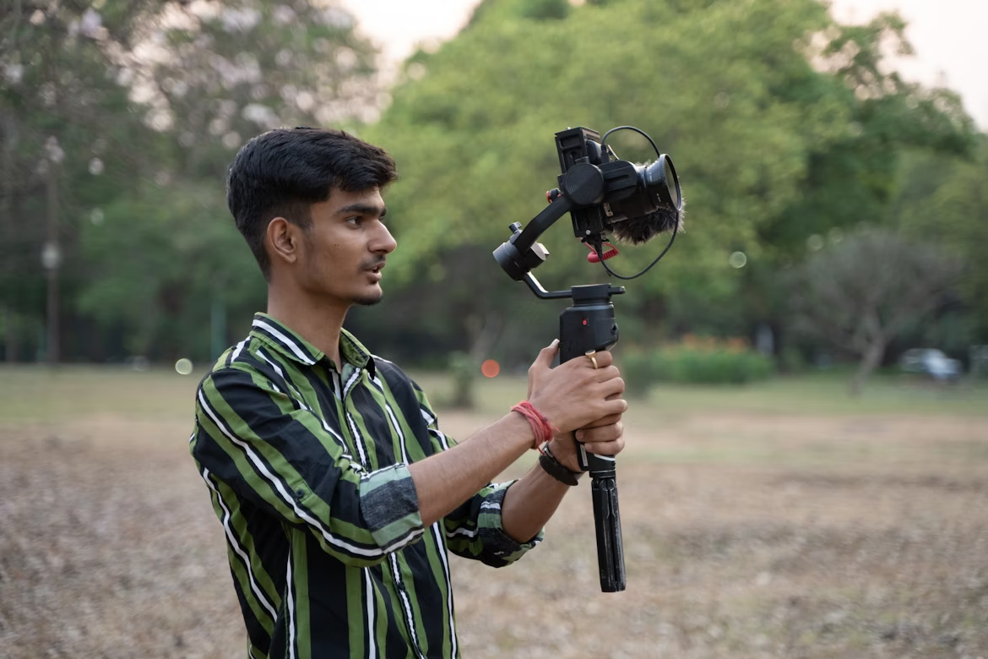
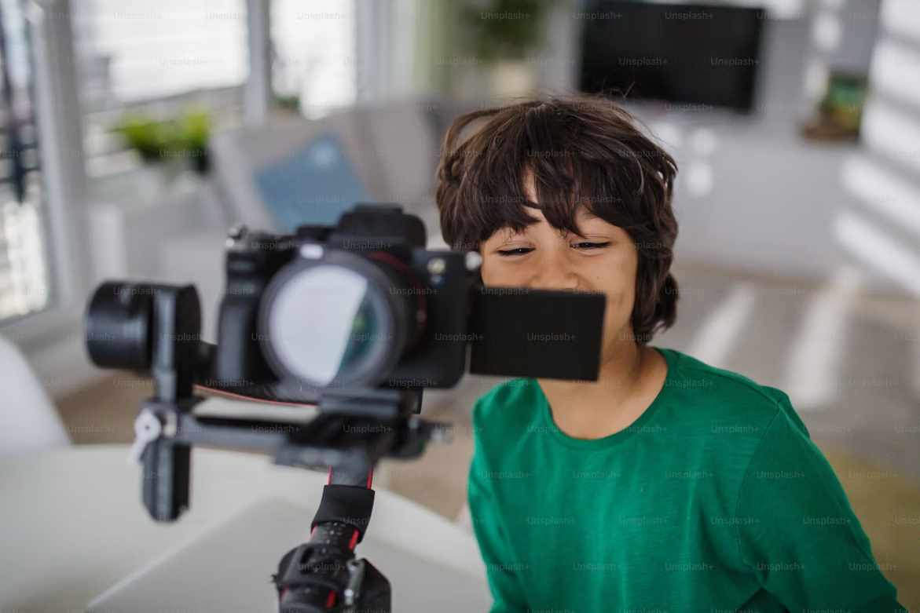
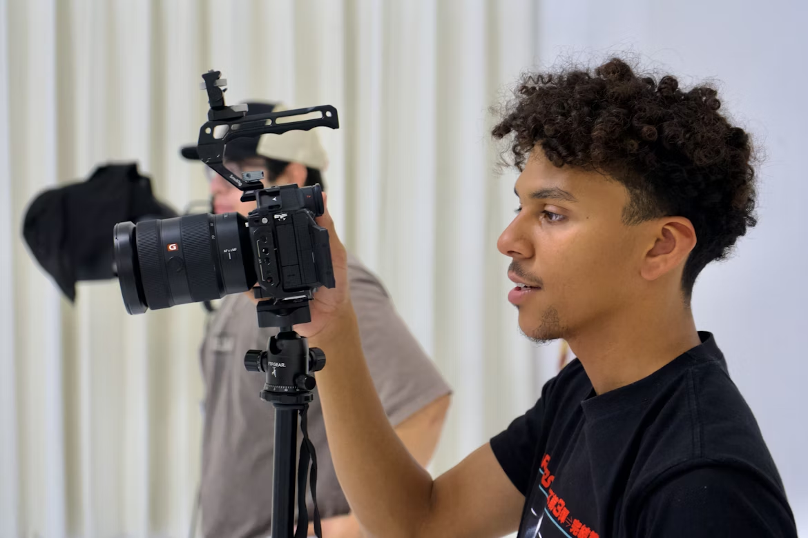
Live Net Zero Video Challenge: A Message to Canadians
Create a short, powerful message that calls for Canadians to step up and take responsibility for a livable future. Show why action matters and how people across the country can help create change.
* Important: Please sign the release form - these can show your face / have clearly identifiable faces. [Be an influencer.]
You can also submit a video to the following Classroom Challenges:
Power Down Challenge
Clothing Rewear & Repair Challenge
True Cost Challenge
Stuff Swap Challenge
Our Traditions Challenge
Costume & Decor Challenge
Nature Restoration Challenge
* Important: There may be additional proof for these 7 Challenges. Please ensure that any videos submitted as proof for these 7 Challenges do not include student names or clearly identifiable faces.
Video Challenges

